Slide 1
Cornerstone Christian School
The journey toward graduation.
Information for grade10-12 students (and their parents)
For students graduating in 2024-2025 & 2025-2026

Slide 2
Graduation Requirements
Grade 10 Core Classes at CCS:
ELA A10 (or 11) and ELA B10 (or 11)
History 10 (or 11)
Science 10 (or 11)
Math at the Grade 10 level:
Foundations & Pre-Calculus 10
Workplace & Apprenticeship 10
Math 11 (modified grade 10 math)
Note that while only one 10-level Math credit is required for graduation, CCS students complete both Foundations & Pre-Calculus 10 and Workplace & Apprenticeship 10 unless a modified math program is better suited to a student’s learning profile.
Wellness 10
*Christian Ethics 10 (CCS requirement; counts towards PAA and/or elective credits)
Courses with “11” are modified (considered regular in terms of graduation requirements, but limit post-secondary options)
Minimum of 8 credits are required to achieve a Gr 10 standing

Slide 3
Graduation Requirements
Grade 11 Core Classes:
ELA 20 (21)
One Math credit at the Grade 11 level:
Foundations 20
Workplace & Apprenticeship 20
Pre Calculus 20
Math 21 (modified grade 11 math)
One Science at the 20 (21) level:
Physical Science 20 (21)
Health Science 20 (21)
Environmental Science 20 (online only)
Computer Science 20 (online only)
*Christian Ethics 20 (CCS requirement; counts towards PAA and/or elective credits)
Courses with “21” are modified (considered regular in terms of graduation requirements, but limit post-secondary options)
Minimum of 16 credits are required to achieve a Gr 11 standing

Slide 4
Graduation Requirements
Grade 12 Core Classes at CCS:
ELA A30 (or 31) AND ELA B30 (or 31)
History 30 (or 31)
*Christian Ethics 30 (CCS requirement; counts towards PAA and/or elective credits)
At least 2 credits in Fine Arts or PAA (10, 20 or 30 level) if not yet earned.
One Social Science (Psychology 20, Psychology 30, or Law 30) if not yet earned.
Courses with “31” are modified (considered regular in terms of graduation requirements, but limit post-secondary options)
Minimum of 24 credits are required to achieve a Gr 12 standing with at least 5 at the 30/31 level

Slide 5
Minimum Graduation Requirement Summary (24 Credits)
Subject Area | Credit Requirements
English Language Arts | Total: 5 2 at grade 10 level 1 at grade 11 level 2 at grade 12 level
Mathematics | Total: 2 1 at grade 10 level 1 at grade 11 level
Science | Total: 2 1 at grade 10 level 1 at grade 11 level
Social Science | Total: 3 1 at grade 10 level 1 History at grade 12 level 1 additional at either grade 11 or 12 level
Health/Physical Education | Total: 1 1 at the grade 10, 11, or 12 level
Arts Ed/Practical & Applied Arts | Total: 2 2 at grade 10, 11, or 12 level
Electives | Total: 9 5 must be at the grade 12 level (30 or 31) 4 more at any level

Slide 6
IMPORTANT!
Meeting the requirements for graduation does not necessarily mean that you have met entrance requirements for post-secondary programs!
It is YOUR responsibility to find out what the entrance requirements are for the post-secondary programs in which you are interested! (Need help with this? Just ask!)

Slide 7
Math Pathways
Workplace & Apprenticeship
10
Foundations &
Pre-Calculus 10
Math 11
(modified grade 10)
Workplace & Apprenticeship
20
Foundations of
Mathematics
20
Pre-Calculus 20
Math 21
(modified grade 11)
Workplace & Apprenticeship
30
Foundations of Mathematics
30
Pre-Calculus 30
Calculus 30
Minimum requirement for graduation: 1 grade 10 level and 1 grade 11 level

Slide 8
Health Science 20
Biology 30
Science 10
Chemistry 30
Physical Science 20
Physics 30
CCS
Face-to-Face Science Pathways Offerings
Physical Science
21
(Modified gr 11)
To graduate: Students must have
Sci 10/11 and one 20/21 level science credit. It’s important to find out what 20 and 30-level science(s) are required by the post-secondary program(s)
you are interested in!
Science 11
(Modified grade 10)
Health Science
21
(Modified gr 11)

Slide 9
Science Pathways including online offerings
Health Science 20
Biology 30
Science 10
Environmental Science 20
Online Only
Chemistry 30
Physical Science 20
Physics 30
Earth Science 30
Online Only
Computer Science 20
Online Only
Computer Science 30
Online Only
Physical Science
21
(Modified gr 11)
To graduate: Students must have
Sci 10/11 and one 20/21 level science credit. It’s important to find out what 20 and 30-level science(s) are required by the post-secondary program(s)
you are interested in. in!
Science 11
Modified Gr. 10
Health Science
21
(Modified gr 11)

Slide 10
So, now you’re in grade 12…
Gap Year
Workforce
Tech/Trade School
Bible College
University
Other ____________
Students in grades 10 & 11 should check this out to get ahead of the game!

Slide 11
So, now you’re in grade 12…
Welcome to a very exciting and busy year!
While the CCS office will send out updates and reminders about some of the approaching deadlines for post-secondary and scholarship applications, the responsibility to know and follow deadlines is YOURS.
Student are encouraged to frequently check and re-check deadlines, requirements, etc. on official websites and not to rely on the summary of dates provided in the career newsletters provided through the office. Institutions and organizations can change things without notifying the school division or school-based staff.

Slide 12
So, now you’re in grade 12…
Parents, now is the time to have your grade 12 son/daughter be the one who checks deadlines, completes applications, contacts institutions and organization for information, asks for references, etc.
It is important to note that the majority of information that is sent out pertains to Saskatchewan institutions only. If you are looking at out of province or out of country options, the onus is on you to do your own research about application processes, documentation, deadlines, etc. The office can assist if you have any questions, but it is unlikely that you will find sufficient information about out-of-province processes in the monthly emails.

Slide 13
Where in the world have CCS Grads Gone after Grade 12?
Brandon University (Brandon, Manitoba)
Briercrest College and Seminary (Caronport, SK)
Canadian College of Performing Arts (Victoria, BC)
Canadian Southern Baptist Seminary & College (Cochrane, Alberta)
Dalhousie University (Halifax, Nova Scotia)
Eston College (Eston, SK)
Holland College (Charlottetown, PEI)
Horizon College (Saskatoon, SK)
Humber College (Toronto, Ontario)
Lakeland College (Vermillion, Alberta)
Lethbridge College (Lethbridge, Alberta)
Medicine Hat College (Medicine Hat, Alberta)
McMaster University (Hamilton, Ontario)
Minot State University (Minot, North Dakota, USA)
Providence University College (Otterburne, Manitoba)
Ryerson University (Toronto, Ontario)
Saskatchewan Polytechnic (various, SK)
Selkirk College (Castlegar, BC)
Simon Fraser University (Vancouver, BC)
University of Alberta (Edmonton, Alberta)
University of British Columbia (Vancouver, BC)
University of Bristol (Bristol, England)
University of Calgary (Calgary, Alberta)
University of Edinburgh (Edinburgh, Scotland)
University of Georgia (Athens, Georgia, USA)
University of Lethbridge (Lethbridge, Alberta)
University of Regina (Regina, SK)
University of Saskatoon (Saskatoon, SK)
University of Toronto (Toronto, Ontario)
University of Waterloo (Waterloo, Ontario)
Vancouver Acting School (Vancouver, BC)
York University (Toronto, Ontario)

Slide 14
Be sure to attend open house and career fair events! *These will be virtual events in 2020-2021 so you can attend without travelling! Watch for information about virtual events in student career News & look up event dates on institution websites!

Slide 15
Be sure to update & use myblueprint!
This is an online comprehensive education and career planner. It supports student exploration, planning, and decision making. TONS of information is available through this site.
Go to www.myBlueprint.ca/prairiesouth
If you’ve logged on before/have an account (many of you do!!)—you need to use your ccsmj email (lastname.firstname@ccsmj.ca)
If you used myBlueprint in another teacher’s class, change the teacher to me (Tanya Johnson, johnson.tanya@ccsmj.ca)

Slide 16
Be sure to update & use myblueprint!
If you’ve never logged on before, do the following:
Click on the “Sign Up” tab
Select “Cornerstone Christian School”
Select “Student”
Select “Grade ___” (whatever grade you are in)
Fill in name & birthday; ignore student number
When asked for email—use your CORNERSTONE ACCOUNT: lastname.firstname@ccsmj.ca
Activation Key: AKEY2293401 (may or may not need to input this)
If you’ve done the assessments in the past… go ahead and re-do them! You change as you grow up!
If you’re asked to include a teacher— use my info (Tanya Johnson, johnson.tanya@ccsmj.ca)

Slide 17
Remember…
Marks do matter!!
Post-secondary programs care that you have the right marks in the right classes.
You need to keep on top of what’s required as admission criteria to post-secondary programs can change from year to year.
Volunteer work is heavily weighted for many scholarships!
Extra-curricular involvement is also factored into many scholarships!

Slide 18
Common Post-secondary admission types
Competitive—These programs establish a base line academic average for acceptance, but will only offer admission to those students with the highest averages.
High Demand—These programs have admission requirements plus additional selection criteria. Examples of potential selection criteria include interviews, career explorations and work or volunteer experience.
First Qualified/First Admitted—Applicants who meet minimum entrance requirements are admitted according to the date of their application.

Slide 19
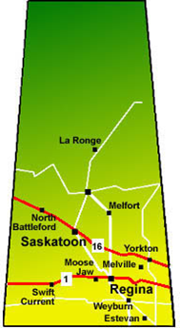
Saskatchewan Post-Secondary
University of Regina | University of Saskatchewan | Saskatchewan Polytechnic
Can start applying now! If marks from grade 11 are not very good, you can apply for most programs after 1st semester– but be sure to check specific program application dates! Generally will use your highest marks for admissions whether they are gr. 12 or gr. 11 marks! | Start applying now and note that Education, Kinesiology, & Animal Bio Science are due December 1 for early admission. Best and Brightest Scholarships- you must apply for program and the scholarships by December 1 | High Demand programs are open now for application First Qualified/ First Admitted programs – apply immediately!!! Many diploma programs that can turn into degrees with two more years at a university

Slide 20
Thinking of going out of province?
Check requirement and admissions policies at each institution
Check deadlines for admissions
Find out how your credits will transfer to that province’s credit system→ Miss J can help with this if needed

Slide 21
What’s the difference between a Scholarship and a bursary?
Scholarship
Bursary
An award for something like:
Marks/academic standing
A specific activity (sports, arts, etc.)
Volunteer work or community contributions
Essay
Video
Special accomplishment(s)
Typically for a student who has financial need
May have academic requirements, but are generally created to help students who do not have the financial resources to pay for post-secondary programs on their own

Slide 22
Transcripts… where do I get them?
The CCS office can provide unofficial school-generated transcripts directly to you for you to forward to post-secondary institutions.
Note that these school-generated transcripts are considered unofficial—all school-generated transcripts in Saskatchewan are unofficial. The ONLY way to obtain official transcripts is to order them through the Saskatchewan Ministry of Education.
If a post-secondary program requires official transcripts OR if the transcripts they require must be mailed or sent electronically by the “sending institution or current school”, you must obtain these transcripts from the Saskatchewan Ministry of Education.

Slide 23
Transcripts Con’t
The CCS office will not send transcripts of any kind (official or unofficial or school generated) to post-secondary institutions for you. The Ministry of Education transcript request site is set up to do this.
There may be unique or extenuating circumstances where we would send unofficial transcripts directly from Cornerstone to a post-secondary institution, but these circumstances would be rare and addressed on a case-by-case basis. If you are unsure… bring in the information from the program you are considering and ask us.
We can provide an official letter stating the classes you are currently enrolled in as well as the classes you are registered to take in the next semester which you can include in an application if required.

Slide 24
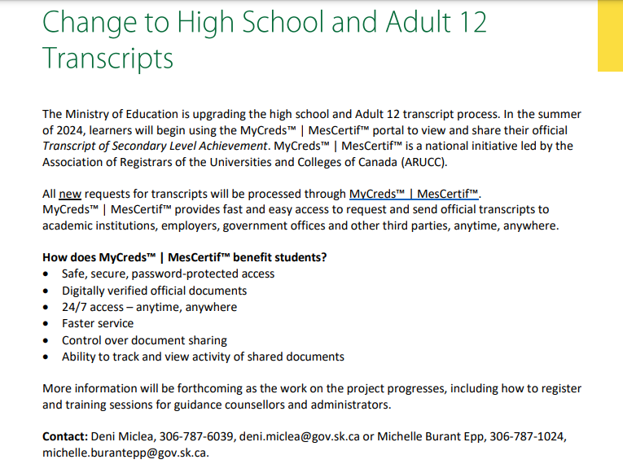
Transcripts… where do I get them?
Miss J will let you know when the SK Ministry of Education releases more details.

Slide 25
Where to find Scholarship Information
Student Career News
Emailed to you & your folks every month
Also posted here: https://www.ccsmj.ca/PostSecondaryandCareerPlanning
https://www.ccsmj.ca/Scholarships1
Information gets added as scholarships become available and applications open
https://www.prairiesouth.ca/students/scholarships/
Application to these scholarships opens in February
You must use your lastname.firstname@ccsmj.ca email address (not a Prairie South or personal email)

Slide 26
Where to find Scholarship Information
https://www.scholarshipscanada.com/
https://yconic.com/
www.scholartree.ca

Slide 27
Where to find Scholarship Information
https://www.uregina.ca/safa/awards/entrance-awards/index.html
Specific to the University of Regina
https://admissions.usask.ca/money/scholarships.php#GuaranteedEntranceScholarships
Specific to the University of Saskatchewan
https://saskpolytech.ca/admissions/resources/scholarships-and-awards.aspx
Specific to Saskatchewan Polytechnic

Slide 28
Where to find Scholarship Information
Your prospective post-secondary institutions’ websites
Ask your parents to check their places of work– many businesses and organizations have scholarships available for employees’ children
Check with you own employer if you have a part-time job– many businesses and organizations have scholarships available for their employees
Search the internet!

Slide 29
Questions???
Ask now
Email- johnson.tanya@ccsmj.ca
Stop by my office

Slide 30
Thank you!
Be sure to read the POST-SECONDARY, CAREER, & SCHOLARSHIP updates!
Feel free to book a time with me to discuss your options or credit requirements.

